Slide 1
JNCIS-ENT
Intermediate System to Intermediate System (IS-IS)

Slide 2
IS-IS Overview
1
An alternative link-state IGP

Slide 3
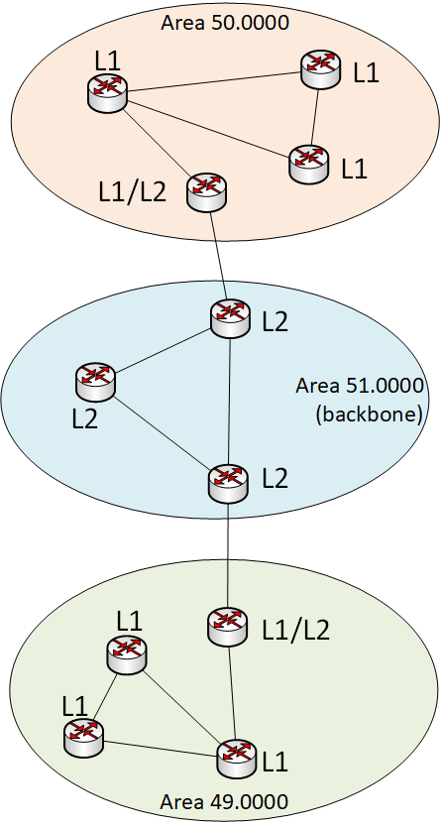
What is IS-IS?
IS-IS is an IGP based on the SPF algorithm
Same algorithm as OSPF that also uses link-state information to make routing decisions
Developed for the OSI protocol suite to route ISO Connectionless Network Protocol (CLNP) packets
IP routing was added at a later time
IP routing addition developed as “integrated ISIS”
Defined in ISO/IEC 10589
And RFCs 1142, 1195 and 2763

Slide 4
IS-IS Terms and Concepts
A continuous IS-IS network is described as a single autonomous system
IS-IS networks contain End Systems, Intermediate Systems and Protocol Data Units
An End System (ES) is a host end device that sends or receives packets
An Intermediate System (IS) is a router that can send or receive packets and also relay/forward packets
A Protocol Data Unit (PDU) is the data unit used by IS-IS speaking routers to exchange information
Like OSPF, IS-IS also has a concept of ‘areas’
Unlike OSPF, an IS-IS router is wholly within a single area, links separate areas rather than routers.
IS-IS organizes routers into Level 1 (L1) and Level 2 (L2) functionality
Only Level 2 adjacencies may cross area boundaries
Level 2 routers are considered backbone routers
IS-IS also has the concept of a Designated Router (DR) which performs the same functions as a DR in OSPF

Slide 5
How IS-IS exchanges information
IS-IS speaking routers exchange link-state PDUs
An IS-IS PDU is similar in concept to an OSPF LSA/LSU packet
IS-IS PDUs are not IP packets, they are the layer 2 protocol used to exchange information
IS-IS PDUs were developed with Type, Length and Value (TLV) fields to allow for future protocol extensions
IP reachability information is exchange through the development of a TLV field to support the information.

Slide 6
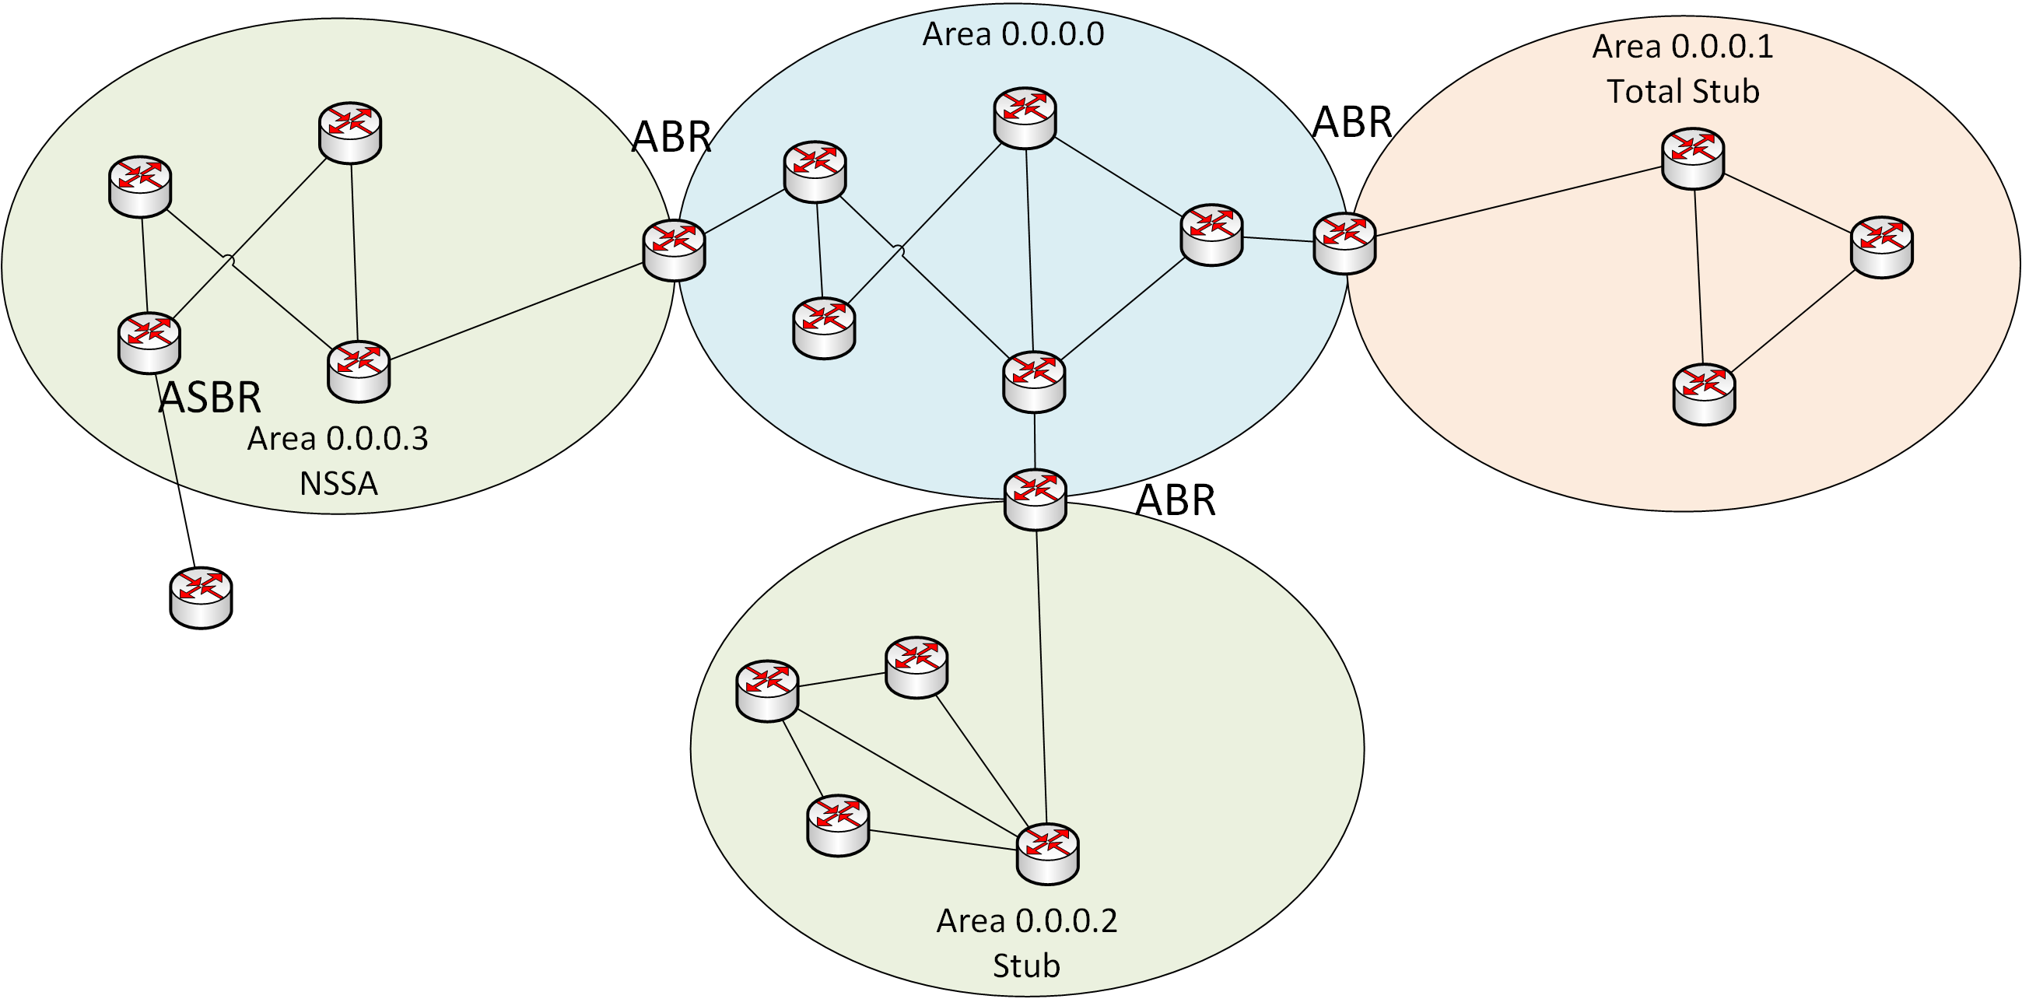
IS-IS and OSPF Similarities
Both protocols:
Are link-state IGPs
Both use Dijkstra’s algorithm
Use ’hello’ packets to form adjacencies
Use a 2-level hierarchical architecture
Have a node role of elected Designated Router

